Slide 1
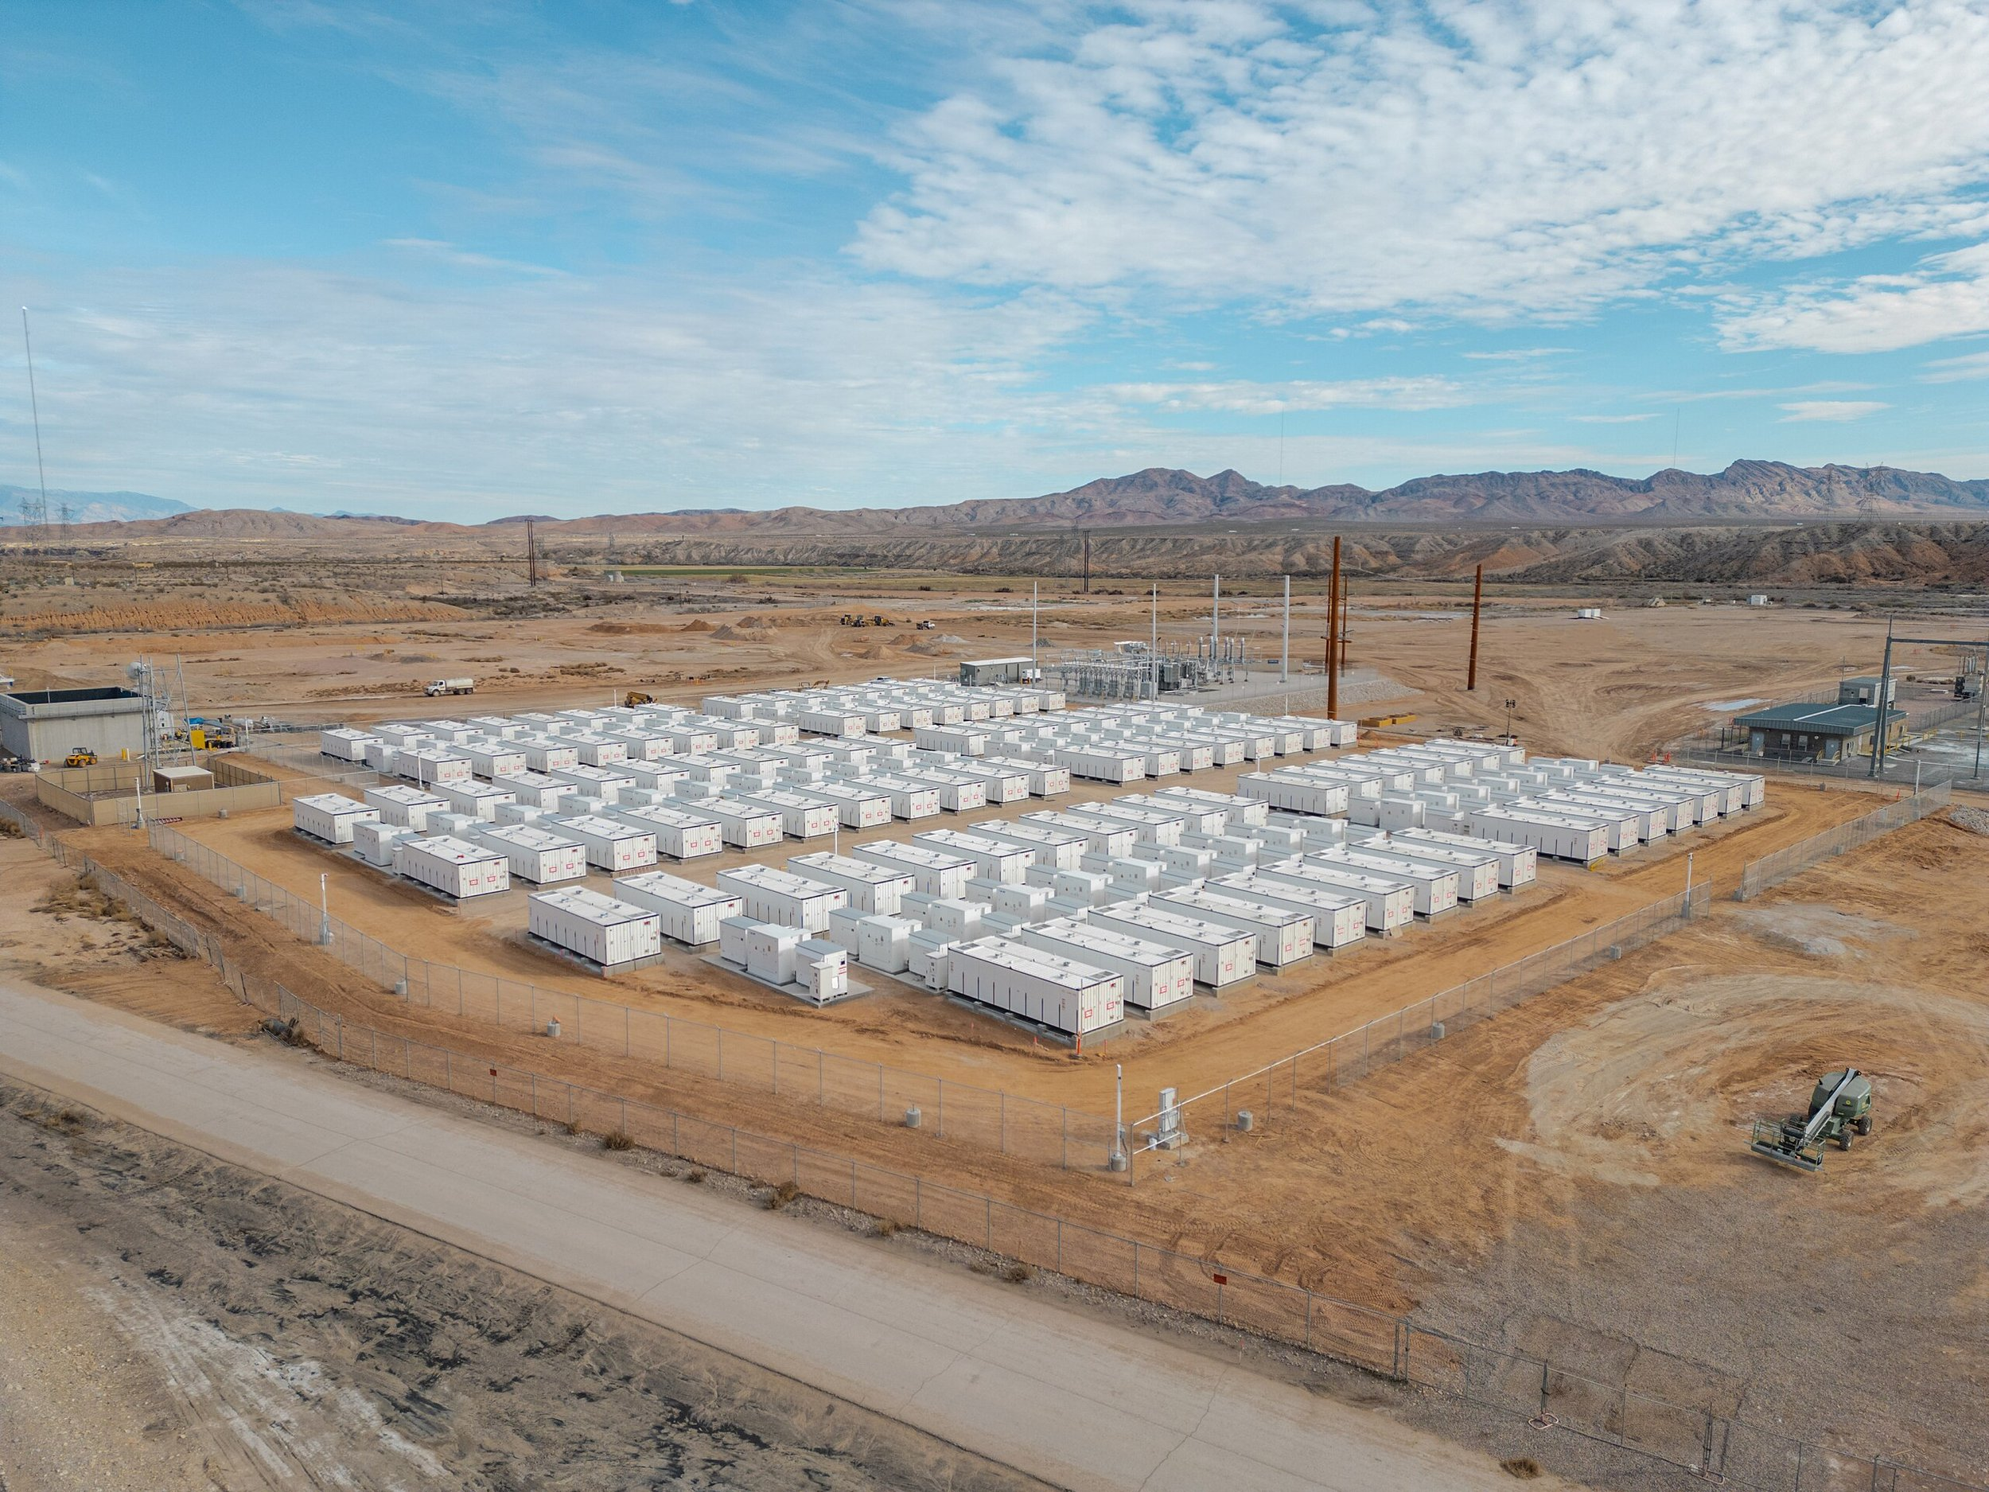

Intelligent Core of Battery Energy Storage Systems
By Sebastian Russo and Javier Peres

Slide 2
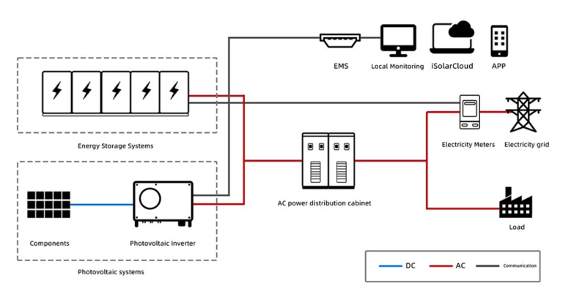
Challenge
Build Battery Energy Storage System (BESS) platform prototype.
Requirements:
Accept and process real-time and historical BESS data
Display actionable insights for technical asset managers
Be extensible for third parties (optimizers, grid operators)
Include at least one innovative feature beyond generic dashboards
EU compliant sensors and controllers

Slide 3
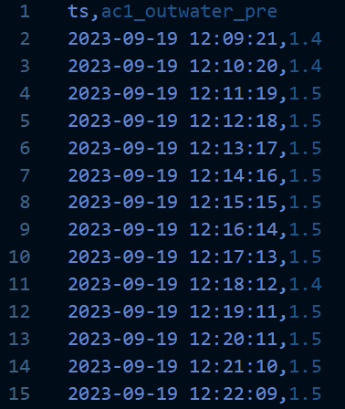
EDA (Exploratory data analysis)
Details:
41 .csv files for each ZHPESS232A23000* directory (Batteries)
5 .csv files for each m* directory (smart meters)
Each csv file contains only a timestamp and a single metric, corresponding 1 for each sensor
6GB in total for data between 2023 and 2025
Many sensors provide data at different frequencies
Standards and conventions not specified
Units specified and relevant values specified in README for BMS, PCS, Aux-Thermal, Env-Safety and Smart meters
Challenging to analyze

Slide 4
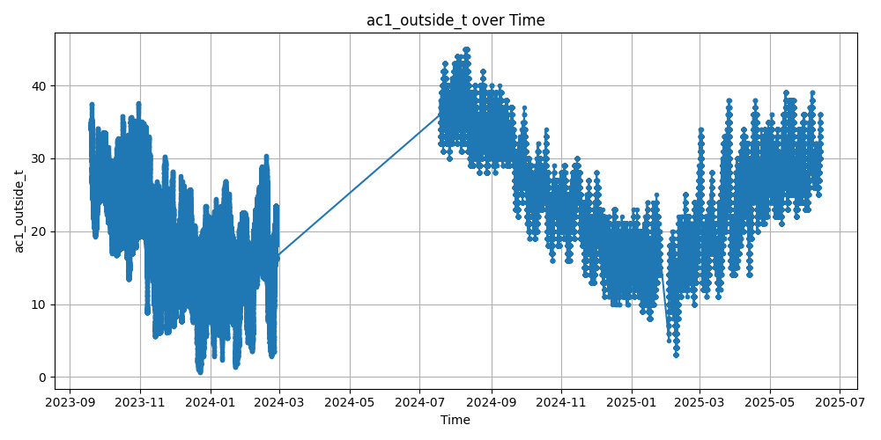
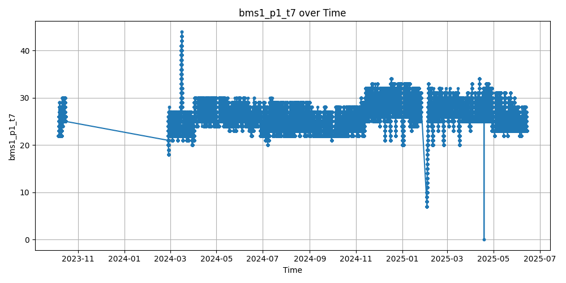
EDA (Examples)

Slide 5
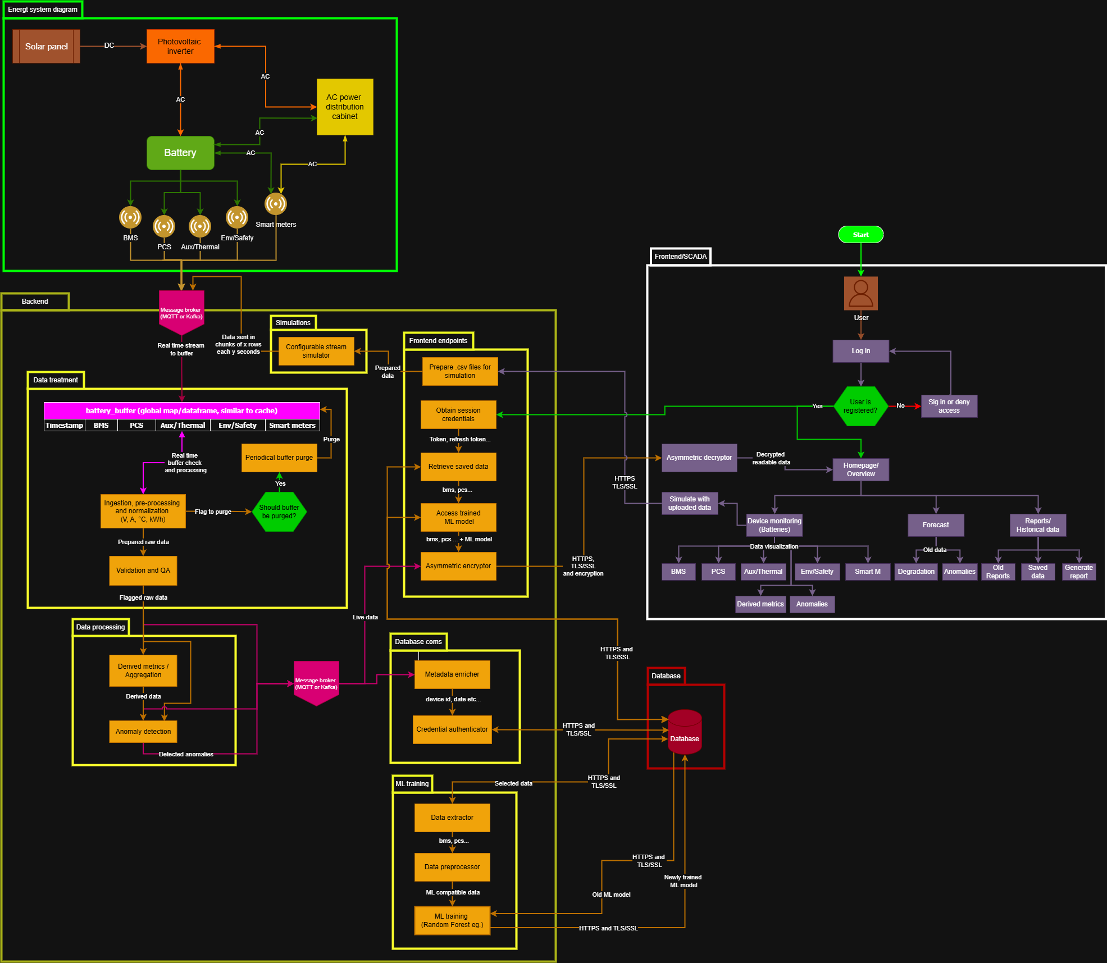
Theoretical architectural workflow
Kinda big right?

Slide 6
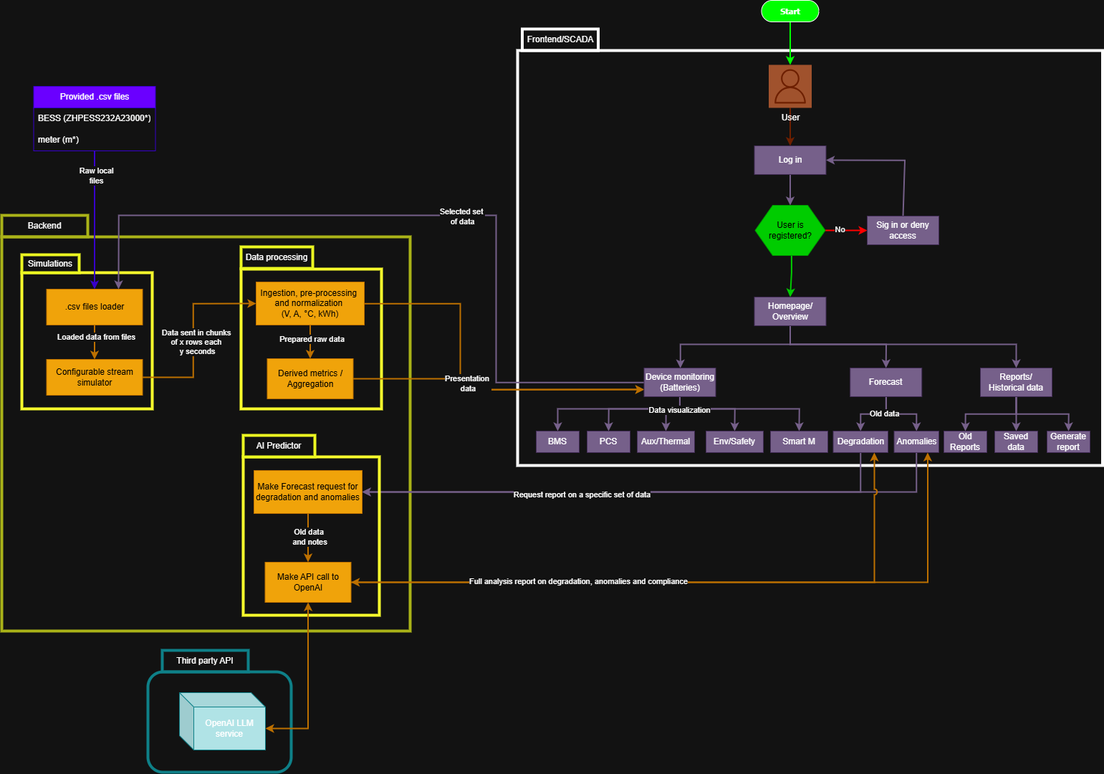
Demo architectural workflow
Much simpler

Slide 7
Thanks

